Slide 1
CNN-Based Road Signs Classification
Presented by: SHAHIN SULAIMAN M
DATE:07.04.2025

Slide 2
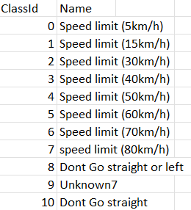
Objective
To build a Convolutional Neural Network (CNN) model to classify road signs into 30 categories.
Enhance autonomous driving and improve road safety using computer vision.
Dataset Description
30 classes of road signs (e.g., speed limit, stop sign)
Dataset includes labeled images.
Dataset split: 70% training, 15% validation, 15% testing

Slide 3
Data Preprocessing
Resized images to 64x64 pixels
Normalized pixel values between 0 and 1
Labels encoded using one-hot encoding
Applied data augmentation (rotation, flip, zoom, etc.)

Slide 4
CNN Architecture
Input Layer: 64x64x3 Images
Convolutional + Max Pooling layers
Flatten layer
Fully connected Dense layers
Dropout for regularization
Output layer: Softmax activation

Slide 5
Evaluation & Results
Evaluated using accuracy, precision, recall, and F1-score
Confusion matrix visualized
Achieved high accuracy and reliable performance
Line plots of training vs validation accuracy and loss
Helps monitor overfitting and model learning trends

Slide 6
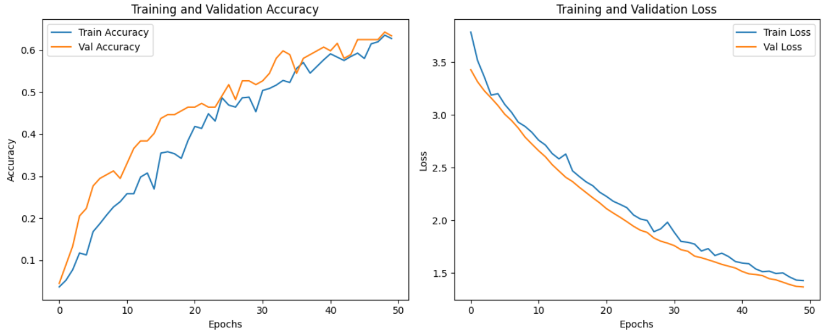
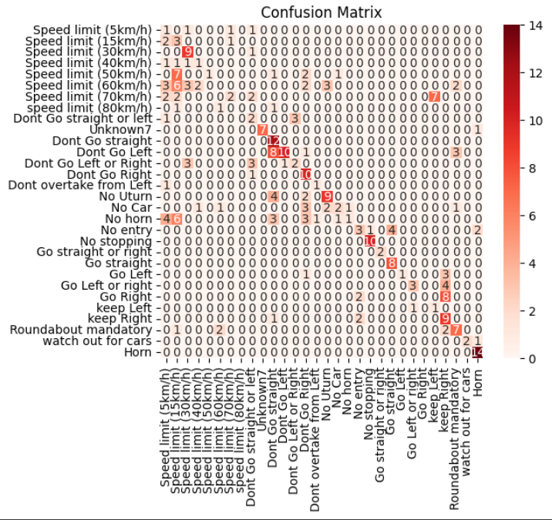

Slide 7
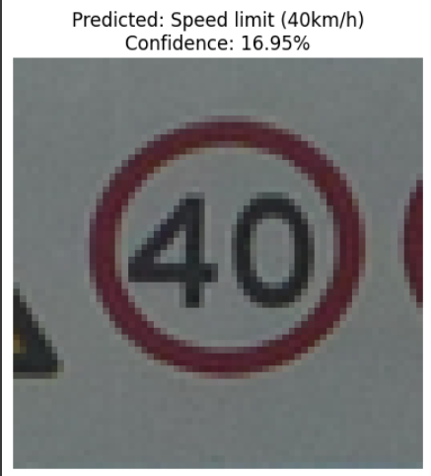
Testing with New Images & Optimization Techniques
Tested model on unseen road sign images
Correctly predicted most signs
Verified real-world application
Hyperparameter tuning: Grid/Random Search
Regularization with Dropout
Tried varying filters and dense layer sizes

Slide 8
Conclusion
Successfully developed and trained a CNN for road sign classification
Potential use in real-time systems for autonomous driving
Future work: Deploy as web app using Streamlit

Slide 9


